Slide 1
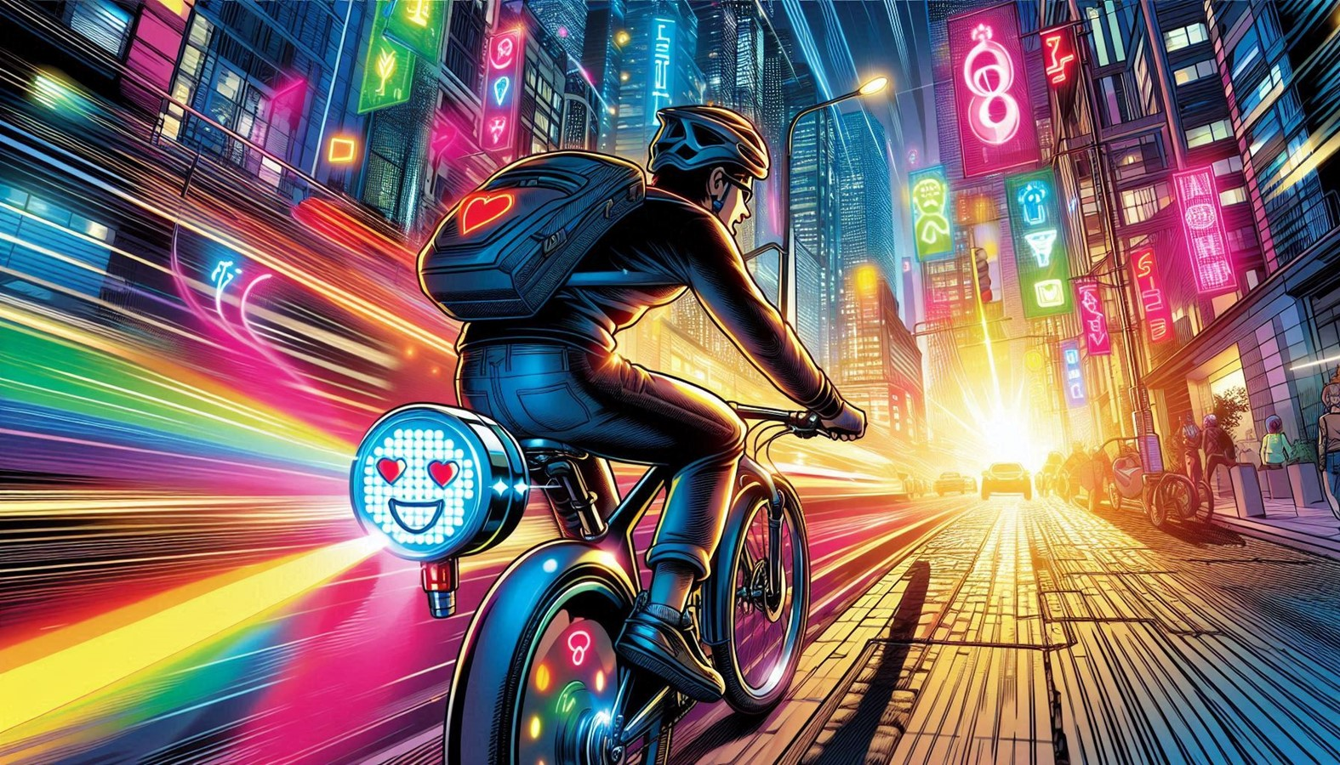
Rittitude
Ride with attitude
SAFETY
×
STYLE
×
BLINK

Slide 2
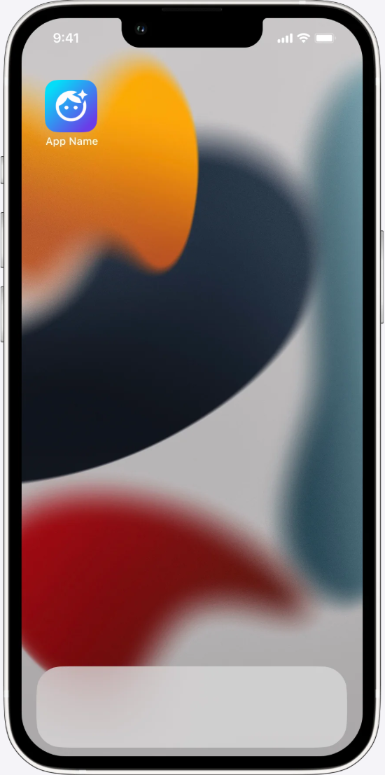

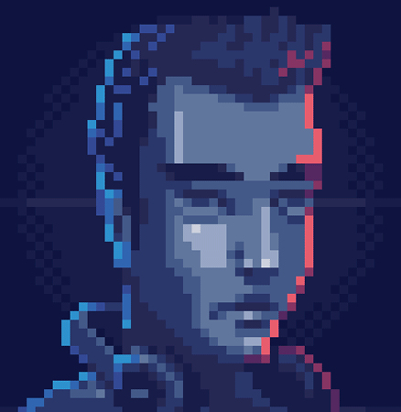
Rittitude
Ride with attitude
Rittitude

Slide 3

Rittitude
Ride with attitude

